Slide 1




Cloud Native Applications
Introduction
Notes:
I want to talk to you about cloud native applications, DevOps, microservices and the processes & platforms for bringing them to production

Slide 2
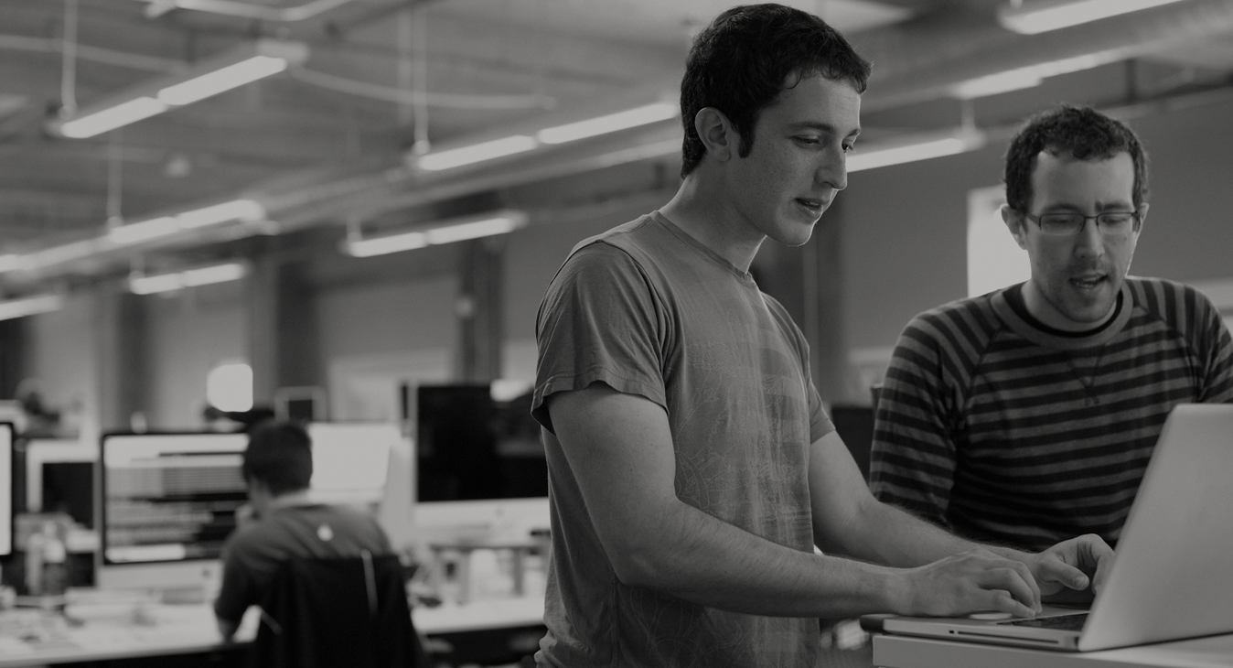

WE BELIEVE
Transforming how the world builds software will shape the future.
Notes:
At Pivotal, we believe Transforming how the world builds software will shape the future.
This is our core guiding principle that shapes our product and corporate strategy
But why change. Why talk about change.
Perfect storm

Slide 3
Agenda
Changing Development Models
Cloud Native Application Platforms
Pivotal Cloud Foundry
Notes:
I wanted to go over some of these emerging development models and
how tech companies have been successful in moving to these highly composable, resilient application architectures that we’re referring to as cloud native applications.
I want to show you what kind of platform tools the leading tech companies had to build.
And how these new designs are really hitting a lot of enterprises, companies that don’t depend on software directly.
We also want to showcase how these projects work together with a demo of a microservice-based Java app, built with Spring Boot and Netflix OSS projects
Before we turn it over to discussion

Slide 4
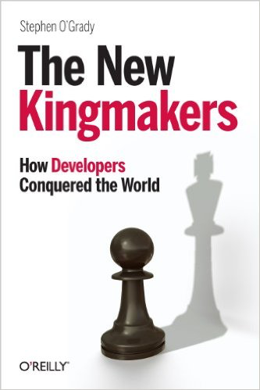
Notes:
Developers are the new kingmakers.
Software is changing (perfect storm)… yes it’s always changing but:
Mobile, always connected story (from starting w/ Call center agents)
Mobile First
Always connected
No downtime
Scale (huge number of users)
Updates (once a month)
3 key drivers
Software is free(ly available) - OSS
Compute is free
Information is free (Internet)
Results
Developers rule the world
Startups have no barrier to entry
*https://sensortower.com/blog/25-top-ios-apps-and-their-version-update-frequencies

Slide 5
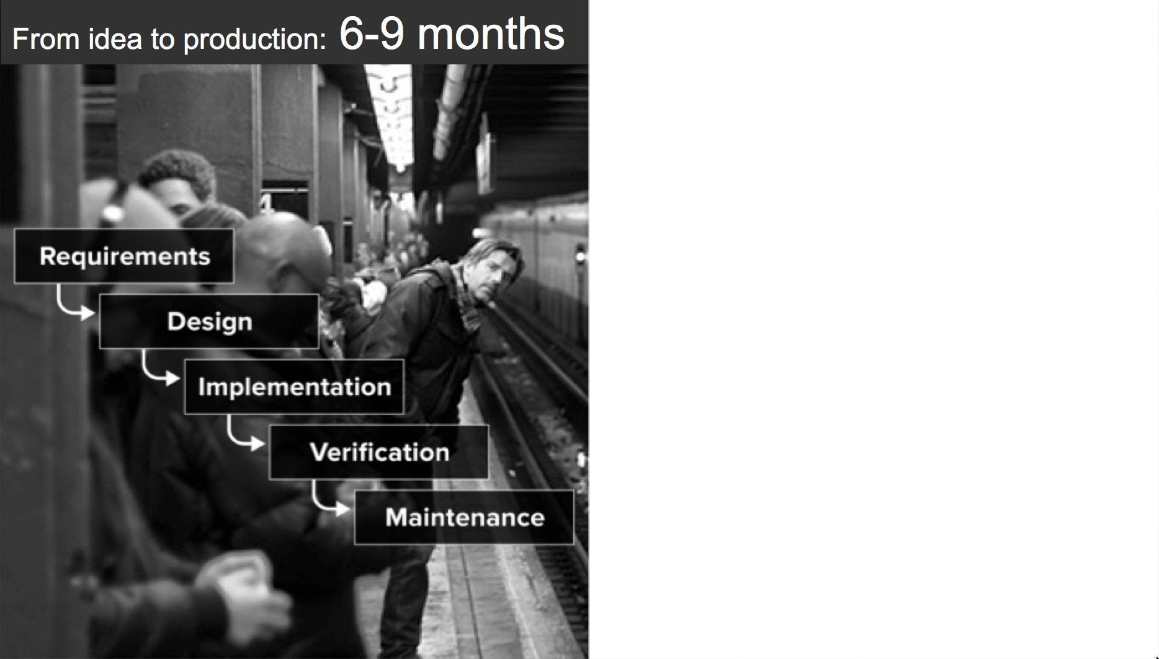
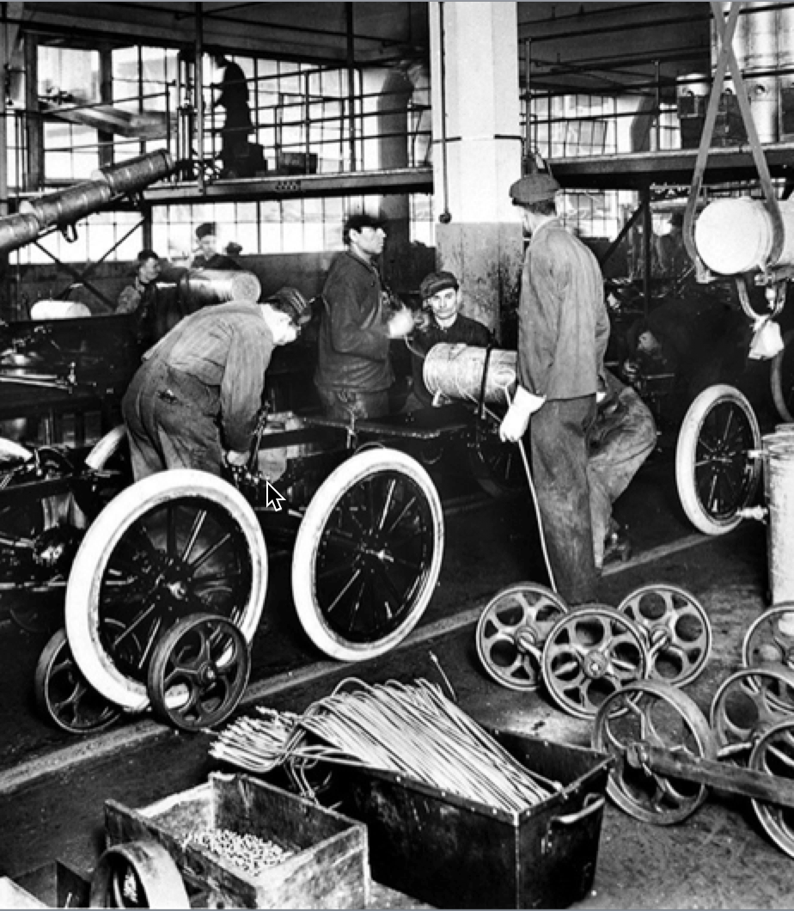
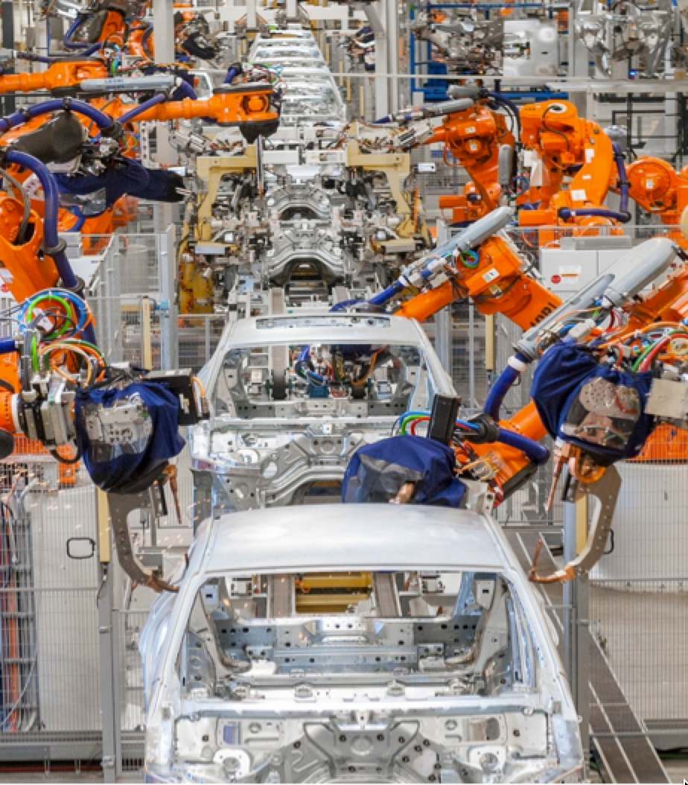
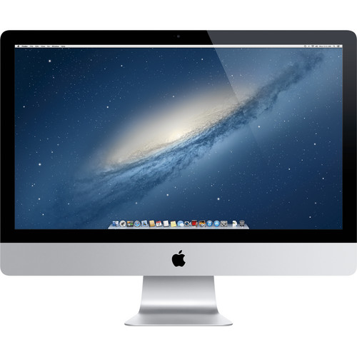
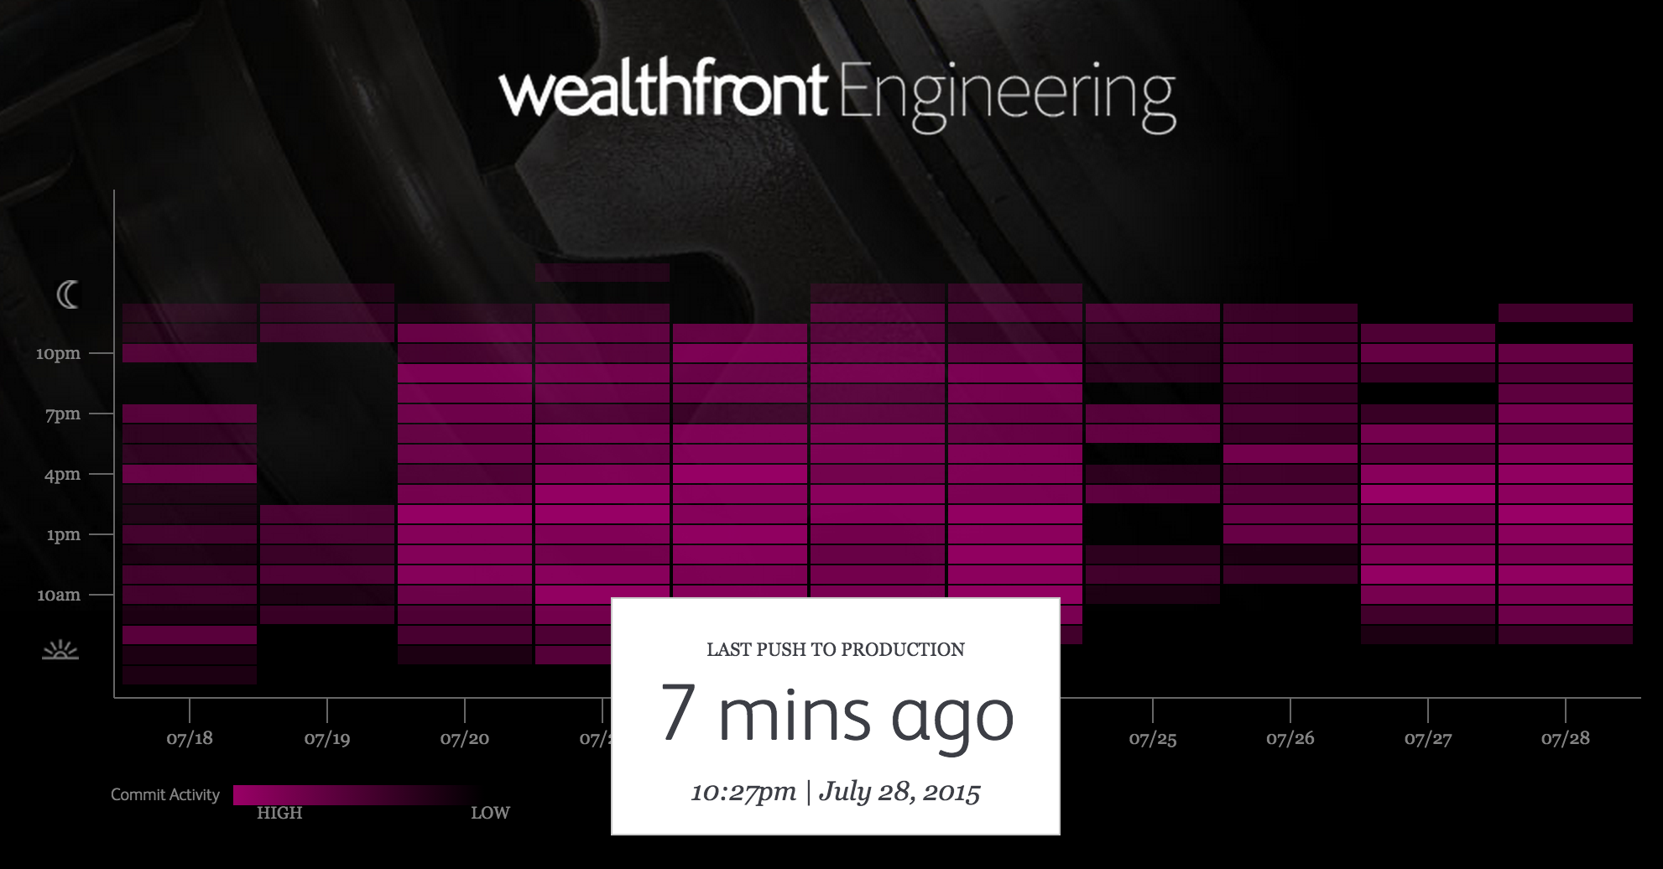

An idea in the morning, is running in production by evening
Then
Now
Notes:
Lets begin the conversation with contrasting the past with the present. Using the auto industry as a backdrop, we examine at how industrialization changed manufacturing for good.
Used to be: slow, manual, error prone, ridged.
We used to ship CDs… and this was a more appropriate way. Whats changed. People now walk around with a super computer in their pocket. Gone are they days of just a couple agents accessing your system...
Internet + Mobile
Freely Availabe Software
Free Compute
A&E – Corporate IT and Broadcast Engineering
Ford Assembly Line from back in the day. Today fully automated
Wealthfront engineering: known for having pivoted away from practice that were slowing them down, to embrace a new agile CI/CD deployment and delivery model that is fully automated. Changing release cycles to minutes instead of days or weeks.

Slide 6
Software Developers Spend too Much Time NOT Writing Software
Design and Coding
Brainstorming
Administrative tasks
Managing Environments
Waiting for Test/Build
Average Hours/Week
17.5 hrs ~ 40% of full work week!
Sources: “Electric Cloud LinkedIn Survey to software developers”
Notes:
And here’s the reality.
You have a precious resource that’s spending TOO much of their time, not doing what you hired them to do. And for good reason.
How much then is the value of each developer’s key stroke to meeting innovation strategy targets? Protecting the developer’s ability to execute on innovation is key to realizing value from investment in top talent.

Slide 7

The developer dream haiku
Here is my source code,
Run it in the Cloud for me,
I do not care how
Notes:
In conclusion,
Cloud native is here - Its not iphone version 1, its not hipster software
We see massive adoption with large enterprise
Trends show –
DevOps
SpringBoot
Software
Talent shortage

Slide 8

The IT Operator reality
It's not enough just to deploy something
That's only Day One
You have to deploy again and again and again
Notes:
Getting software to production is just the first step. Running and maintaining it is far more.
Over 60% of the cost of software comes from maintaining and running it. http://www.irahul.com/2005/10/software-development-vs-software.html

Slide 9
IT Ops Spends Time Building Snowflakes
Request VMs
Request Network
Request Software Install
Request Database
Random Network Troubleshooting
DAYS
14
4
4
8
6
11
40
14
60
2
Nearly 6 months later
Production
Random Middleware/OS Troubleshooting
Develop App
User Acceptance Testing
QA/Production Deploy Pipeline
Scale Up/Down
Notes:
As an example, here is a sample company that is bogged with too much legacy culture, process, and technology. In fact, this is quite generous. You know, it takes some companies three months to request a new VM, and once all is said and done, if they even have User/QA, the security teams have to do an internal review for vulnerability and compliance. Its no wonder that companies are falling behind! Sometimes I think all the process in place is just there to keep people employed, and a lot of this kind of thing has to do with company culture and legacy everything. Changing for the long run, only elevates everyone to levels of business which realizes the greatest value.

Slide 10


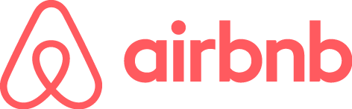


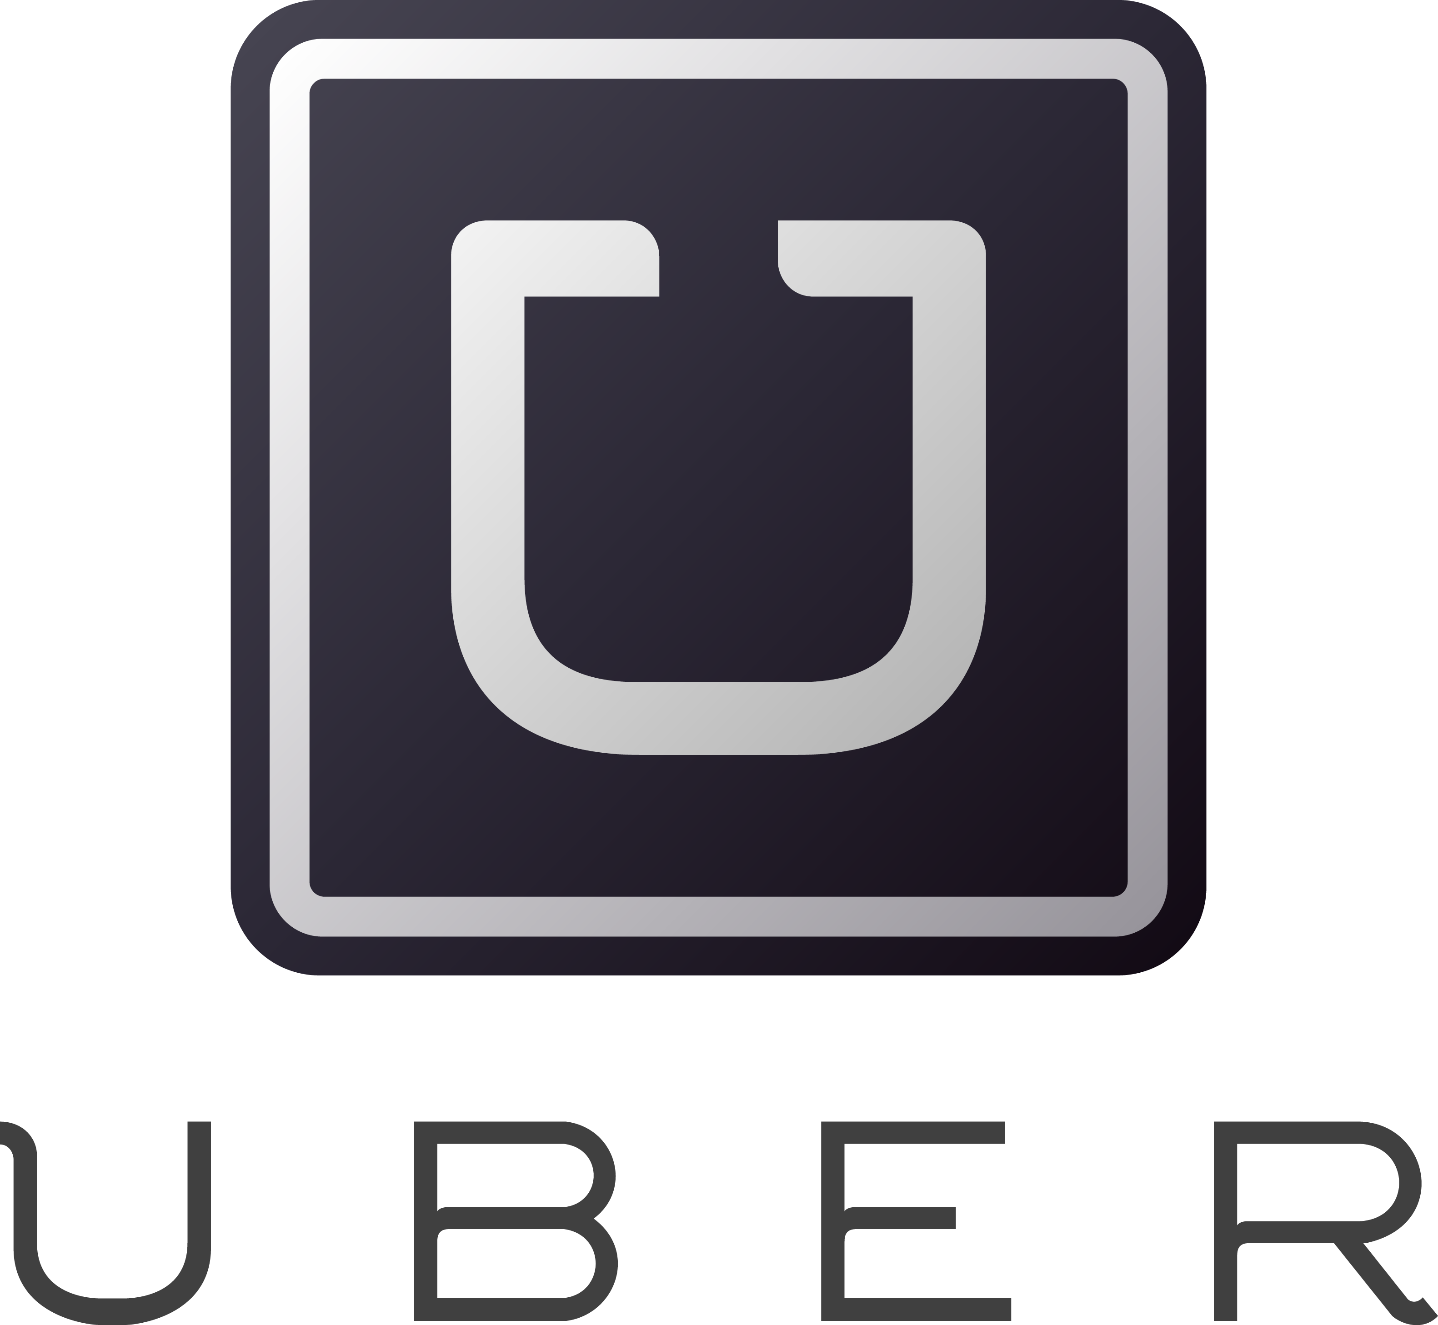
Software is changing INDUSTRIES
$6BN
Financial Services
$53BN
Entertainment
$26BN
Hotel
$34BN
Automotive
$50BN
Transportation
$3.2BN
Industrial Products
Notes:
Now, you might have seen some version of the story where several Silicon Valley companies are disrupting traditional industries and creating tremendous value.
Uber has no cars, AirBnB owns no real estate, Facebook doesn’t generate content and Amazon has no retail stores. This is all based on software. And that’s really a great story
To be honest, the only companies on this slide I have never used myself are a Tesla, and a Nest, however the ones I do use have saved me alot of money. How can a business offer a better service, faster, and cheaper for themselves, and me? The key is agility.
--
The first law of disruption? Disruption is inevitable. However it is avoidable!

Slide 11

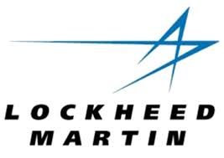
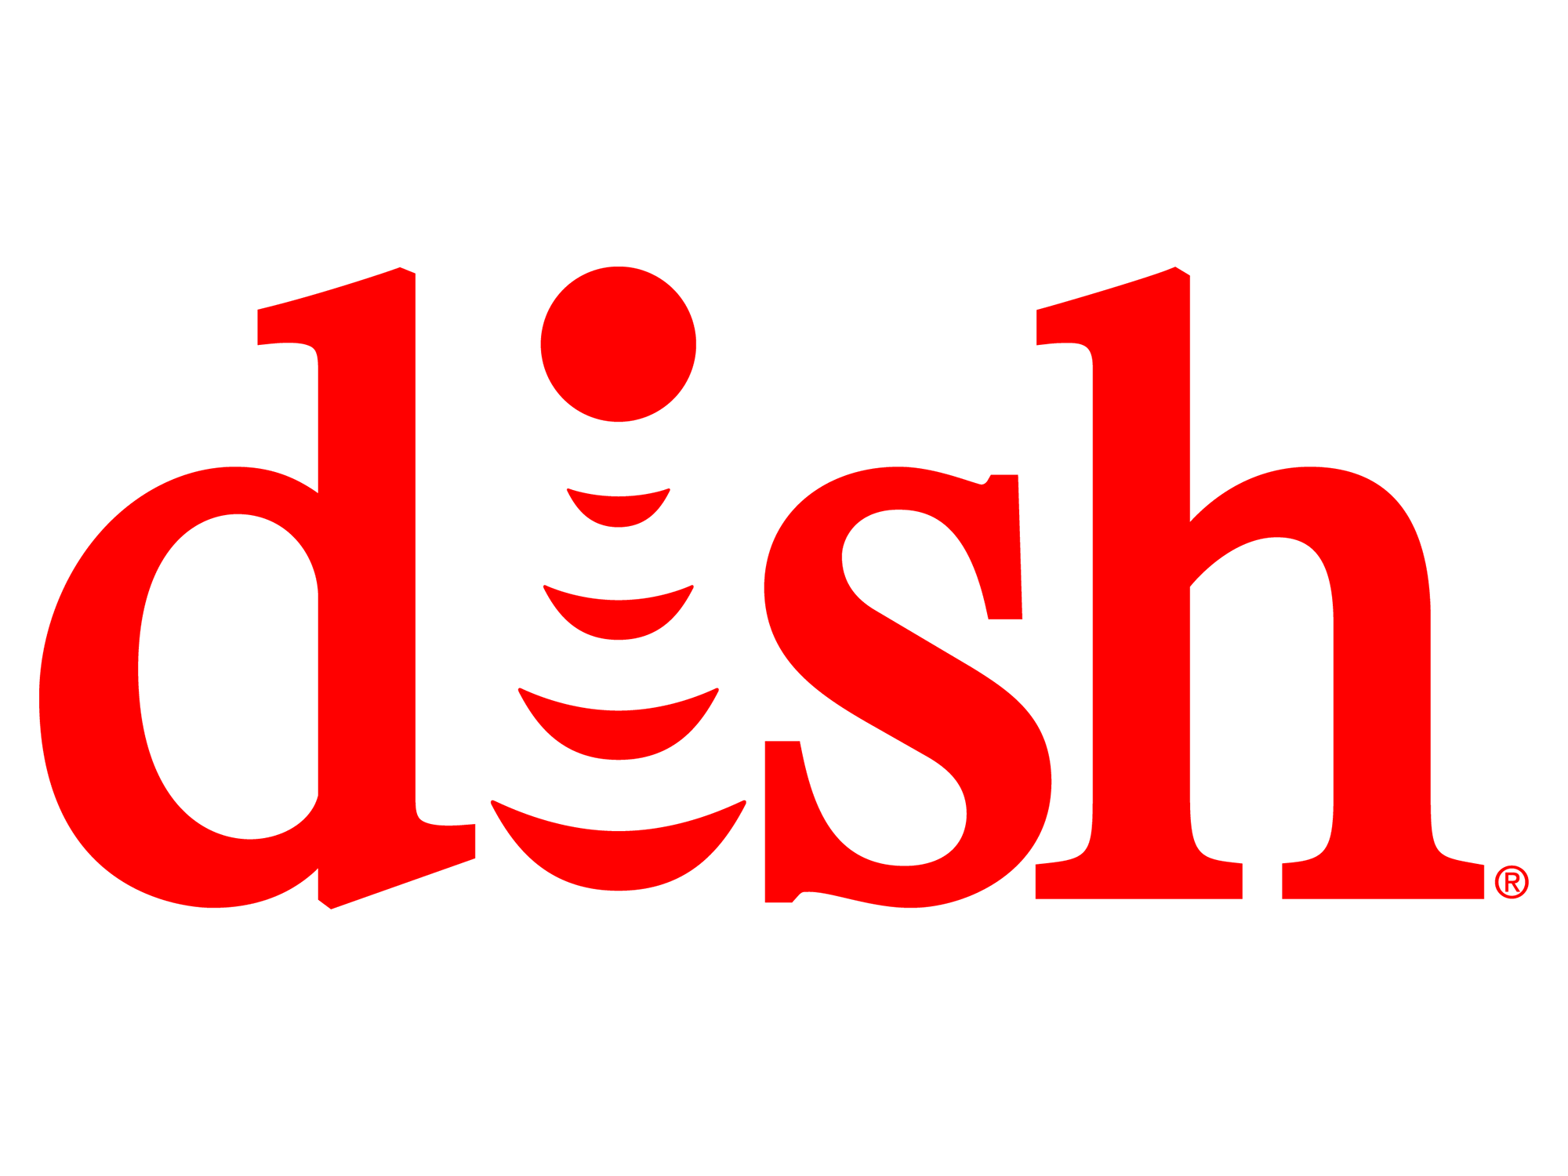
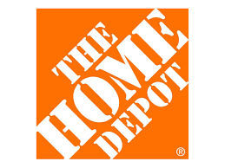
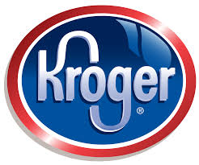
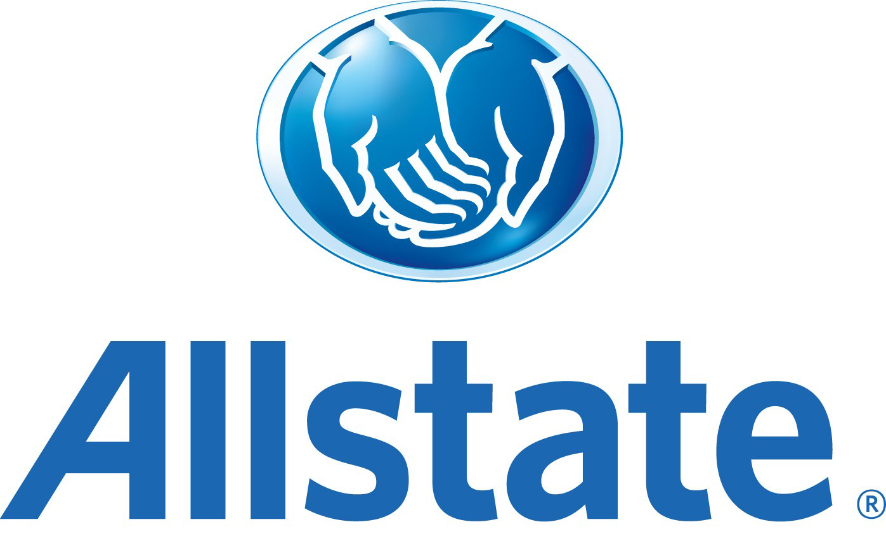
The Enterprise REVOLUTION
$138BN
$62BN
$34BN
$145BN
$108BN
$23BN
Notes:
However, we don’t hear as much about the as the massive enterprise revolution at play.
These are brick and mortar, solid revenue generating, dividend paying companies that are all adopting Pivotal Cloud Foundry and changing the way they build and deploy software.

Slide 12
The Enterprise REVOLUTION
700+ apps
Spring + PCF
Re-writing software the modern way
Agile software transformation
DevOps adoption with PCF
Automated build pipeline
Major IT transformation
Notes:
Speak to each of the companies

Slide 13
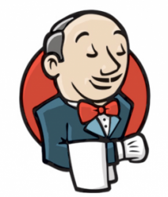
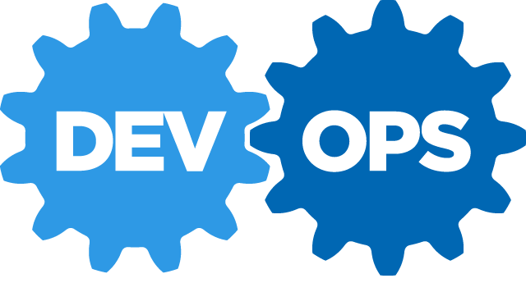
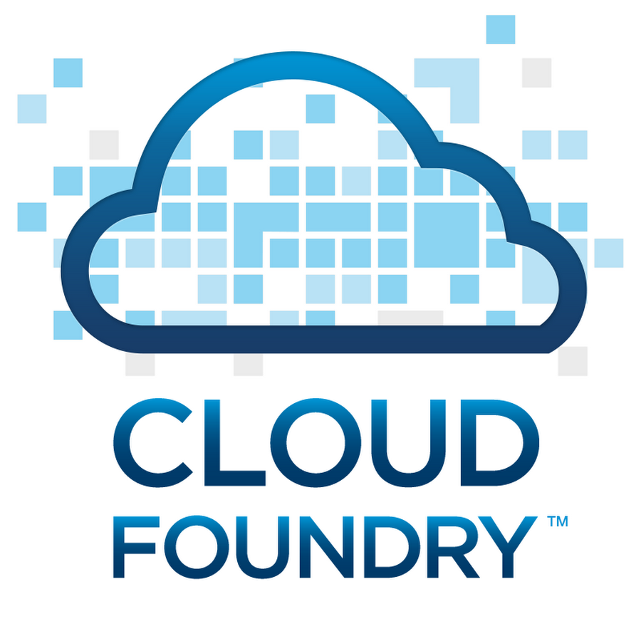
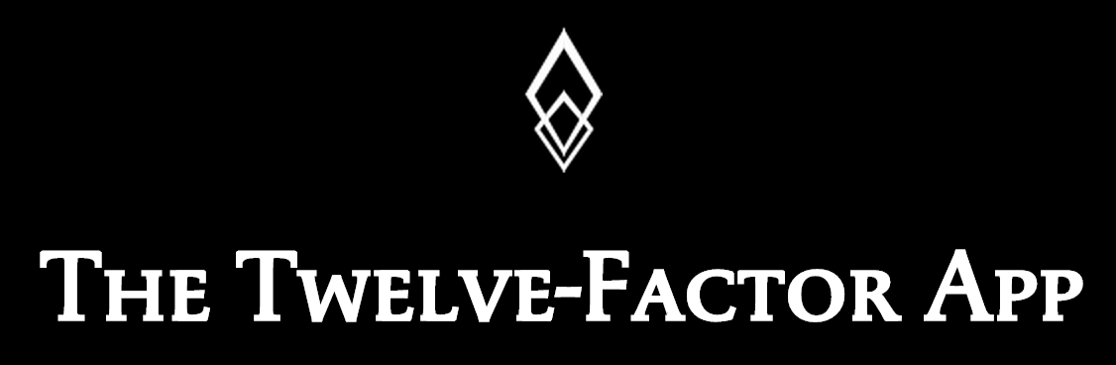

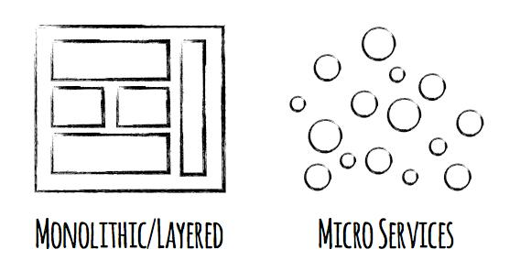

Software is CHANGING
Continuous Delivery
Spring Boot
Notes:
Software is changing industries but software itself is changing. You hear a lot about buzz-words and new technologies coming to play with ideas such as Microservices, DevOps, Continuous Delivery and of Containerization of workloads made popular by Docker.
Being a modern developer is challenging because it requires constantly updating ones knowledge and skills, but its also so exciting, because never before have we been able to get into the flow with less technical roadblocks.
By the end of today, youll be fluent in all these technologies.

Slide 14
DevOps
Continuous Delivery
Microservices
Not my problem
Separate tools, varied incentives, opaque process
Release once every 6 months
More Bugs in production
Tightly coupled components
Slow deployment cycles
Shared responsibility
Common incentives, tools, process and culture
Release early and often
Higher Quality of Code
Loosely coupled components
Automated deployments

Slide 15
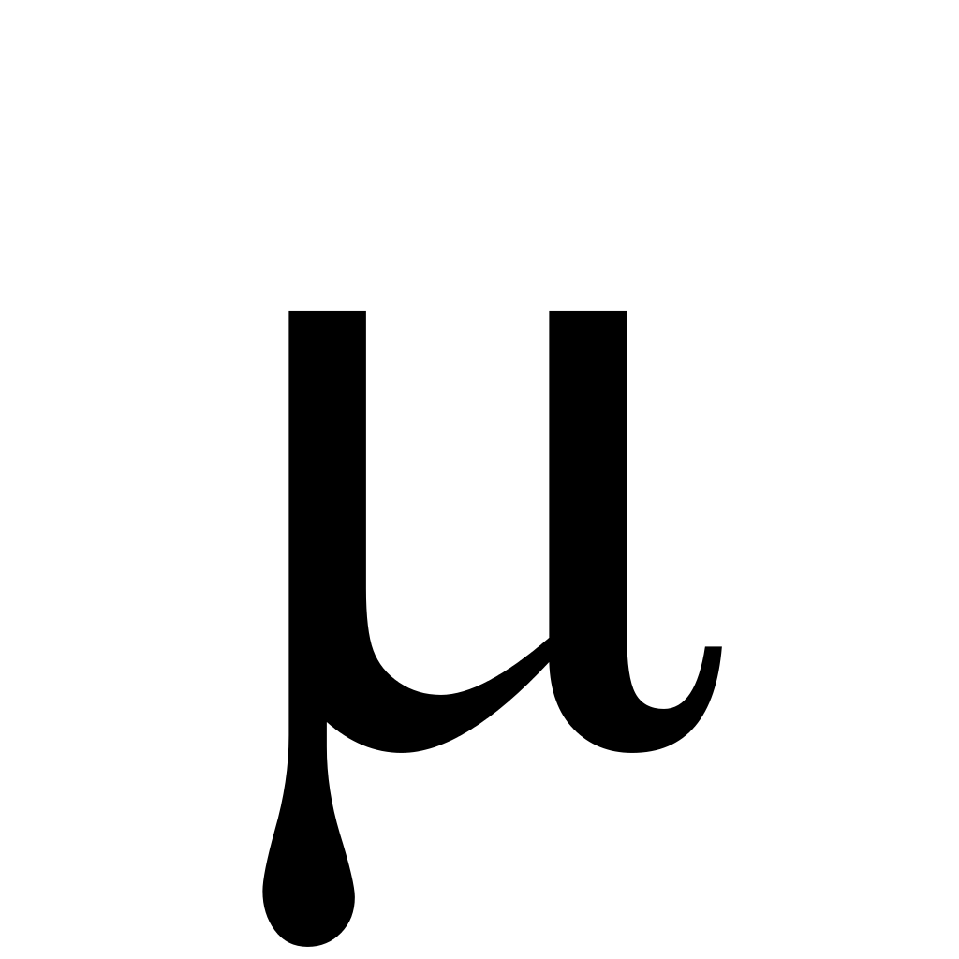
Cloud Native Reference Architecture (Ecosystem)
DATABASES AND DATA MANAGEMENT
Traditional RDBMS
Oracle MySQL
SQL Server
NoSQL datastores
MongoDB Cassandra
Couchbase
VERSION CONTROL
Github
Gitlab
SVN
CI / CD
Jenkins
Concourse
Artifactory
SECURITY & COMPLIANCE
OAuth
UAA
LDAP
Kerberos
SSL/TLS
PCI
HIPAA/HL7
METRICS & DASHBOARDS
Collection
Storage
Dashboards
Alerts
Spinaker
DEVELOPMENT FRAMEWORKS
Spring / SCS
Entity Framework
Micro
API MANAGEMENT
APIGee
Mashery
DIY
DATA MICROSERVICES
Spring Cloud DataFlow
Storm
Fink/NiFi
LANGUAGES
Java
.NET
Python
DISCOVERY & REGISTRATION
Consul
Eureka
etcd
CIRCUIT BREAKERS
Hystrix
DIY
LOAD BALANCING
Ribbon
Zuul (client side)
Ruby
Go
*.JS
Zookeeper
Where should your best developers focus to maximise BUSINESS VALUE?
What does it take to deploy and operate ALL this at SCALE
Docker Garden runC
MONITORING & LOGGING
Log Aggregation
Storage
Thresholds
Metering
CONTAINERS
MESSAGING
Kafka RabbitMQ
CONTAINER
ORCHESTRATION
Cloud Foundry Runtime Kubernetes Swarm Marathon ECS
NETWORKING
DNS
Load Balancing
Intelligent Routing
Network Segmentation
Firewalls
CLOUD ORCHESTRATION
& AUTOMATION
BOSH / Cloud Foundry Chef Puppet Ansible SaltStack Mesos
PRIVATE CLOUD
PUBLIC CLOUD
vSphere OpenStack
AWS GCP Azure

Slide 16
It Takes a Platform
An end-to-end structured platform that makes implementing distributed application best practices, a turn-key and first practice
Notes:
Mention the opinionated platform.
Structured vs Unstructured.
The word platform is thrown around alot these days. You’ve probably heard the word PaaS a few times already – its become the word of the year already. However, lets make a distinction, structured platforms vs unstructured platforms.

Slide 17
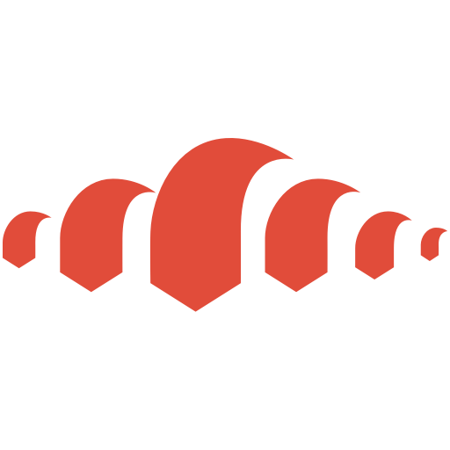
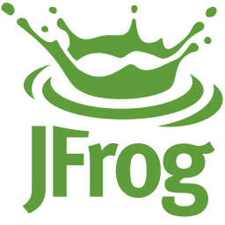
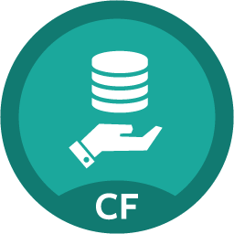
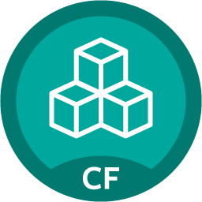

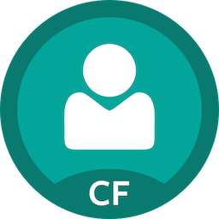
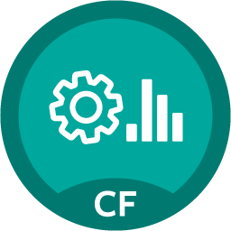
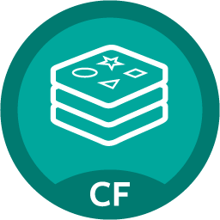


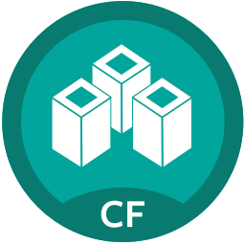
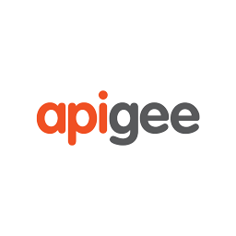
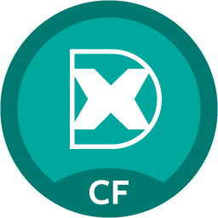
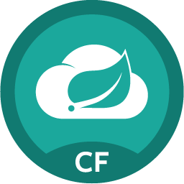

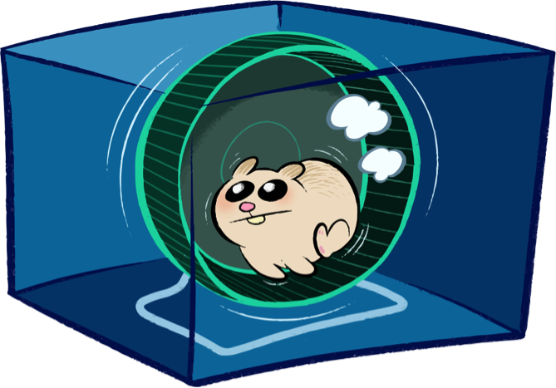
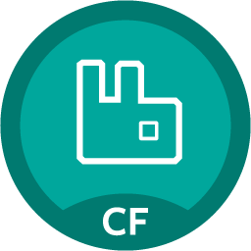
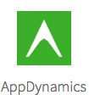
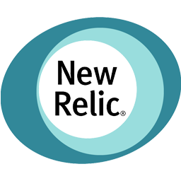
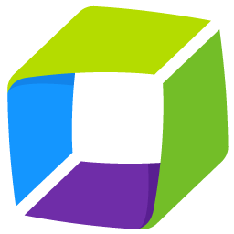
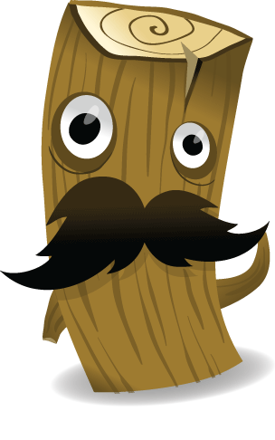

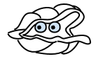
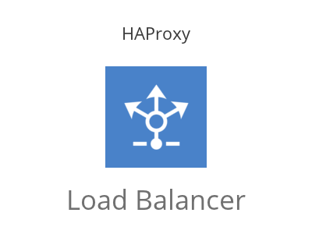
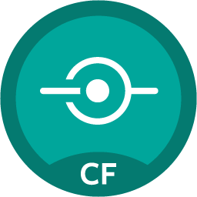




Cloud Native Reference Architecture (PCF)
DATABASES AND DATA MANAGEMENT
VERSION CONTROL
CI / CD
SECURITY & COMPLIANCE
SSO
IPSEC
METRICS & DASHBOARDS
PCF Metrics
Ops Manager UI
Gitlab
Ops Manager Director
Jenkins Artifactory
Operations Manager
MySQL Gemfire
DEV FRAMEWORKS
Buildpacks
API MANAGEMENT
Redis Pivotal HD
Service Broker
DATA MICROSERVICES
LANGUAGES
Java
.NET
Python
DISCOVERY & REGISTRATION
Consul
Eureka
etcd
CIRCUIT BREAKERS
Hystrix
DIY
LOAD BALANCING
Ribbon
Zuul
Service Nodes
Ruby
Go
*.JS
Spring Cloud
Dataflow
Service
MONITORING / LOGGING
CONTAINERS
MESSAGING
Docker RunC
RabbitMQ
Service Broker
CONTAINER
ORCHESTRATION
PCF Elastic Runtime
Service Nodes
NETWORKING
CLOUD ORCHESTRATION
& AUTOMATION
Service
BOSH / Cloud Foundry
PRIVATE CLOUD
PUBLIC CLOUD
Azure
HA Proxy Router

Slide 18
Application-centric Platforms
Business Value, Agility & Cost Savings
Traditional IT
IaaS
Cloud Native
You Manage
Applications
You Manage
Applications
Applications
Data
Data
Data
You Manage
Runtime
Runtime
Runtime
Middleware
Middleware
Middleware
Pivotal CF
+
Choice of IaaS
O/S
O/S
O/S
Virtualization
Virtualization
Virtualization
Servers
Servers
IaaS
Servers
Storage
Storage
Storage
Networking
Networking
Networking
Notes:
So where is T-Mobile in this picture?
We’ll get into cloud native later, but at a high level its the architecture purpose built to run applications in the cloud, at enterprise scale. To do that, we must automate all the repetive tasks. This is the entire stack, up to the point of an individual key stroke, and bits of data used and consumed by an app. Only when the developer is free to only think of code, i.e. the business problem, will full value to the business be realized.

Slide 19


D e m o
Notes:
Scale Demo – its the fastest to stage
Do not go too deep into all the features if PCF.
Session 2 will cover Org, Space, buildpacks, Containers, Scaling, etc
If this needs to be a full demo because stakeholders in the room, make sure not to talk too much to leave little time for the Labs, OK to deferr questions to the next Session on Arch and if the student is going to be in the lab for the rest of the workshop.

Slide 20
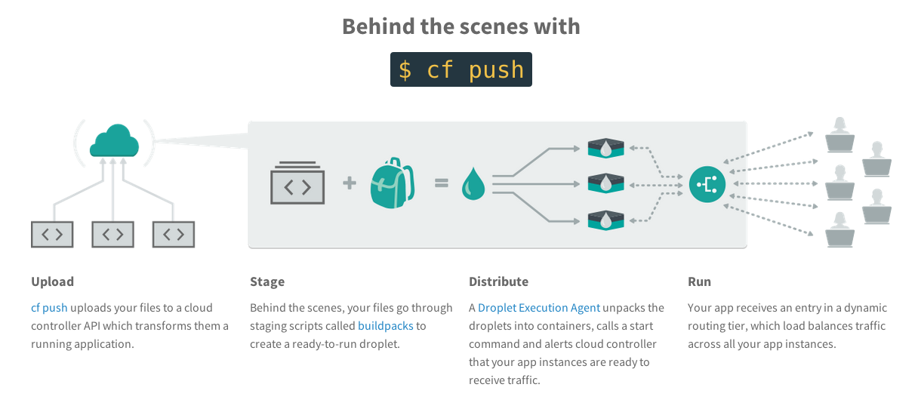
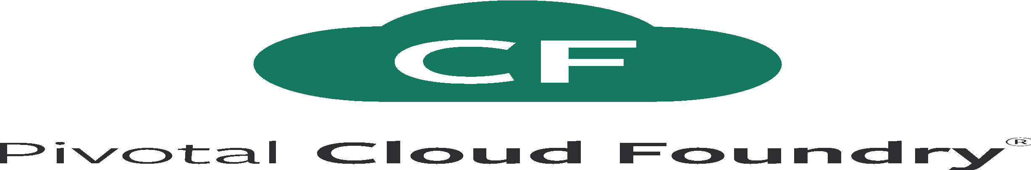
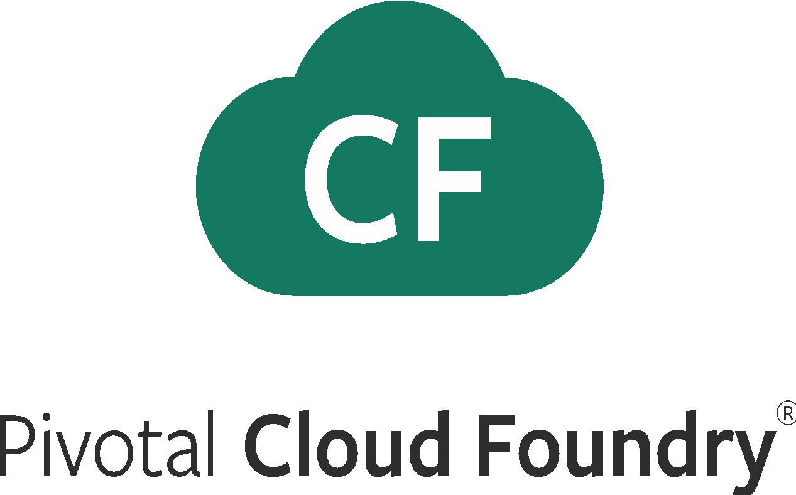
What Just Happened?
Notes:
Upload the bits
Stage: make a droplet
Distribute: execute in containers
Run: become routable

Slide 21
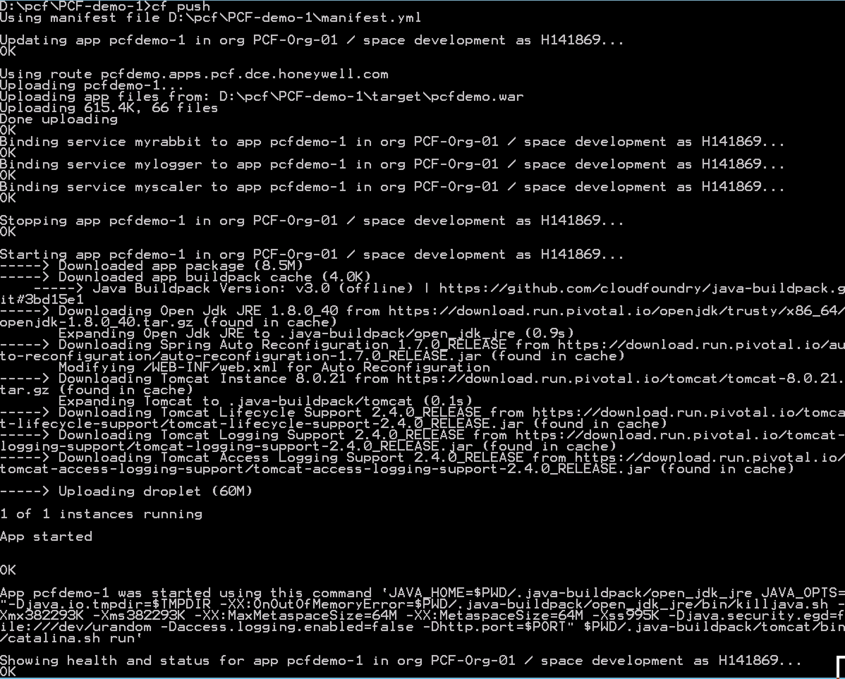
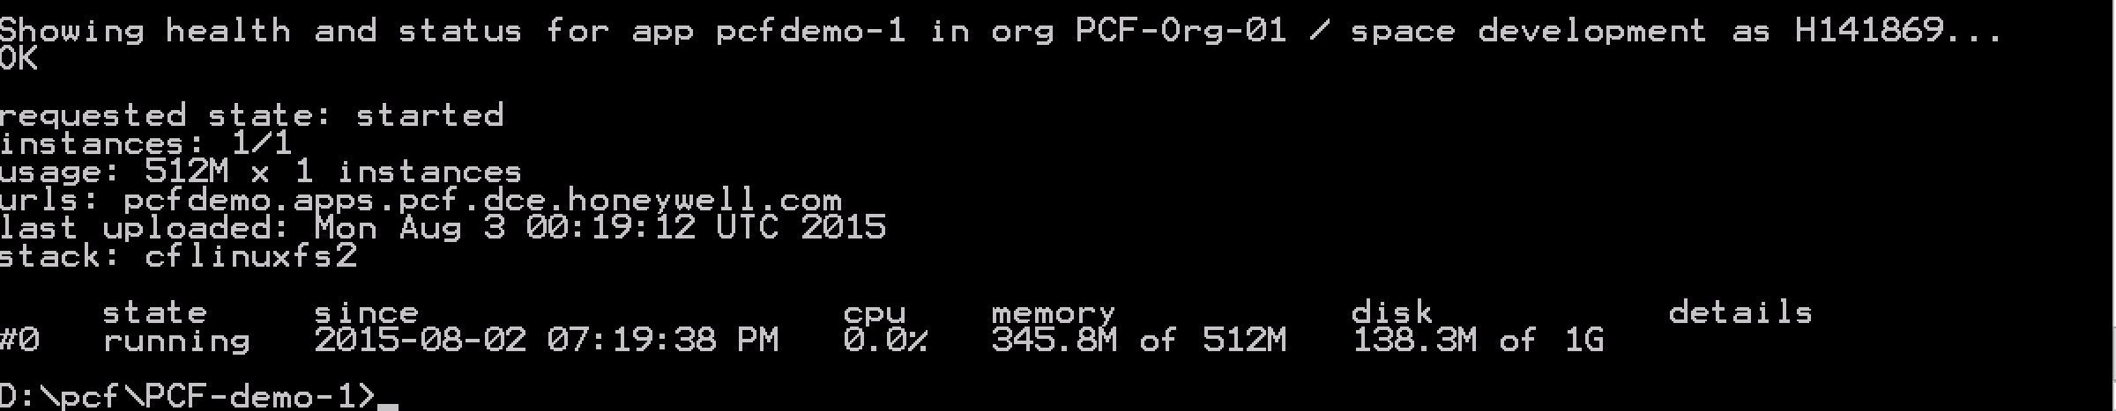
Full Stack Ticket Elimination
Firewall & Routes
Service Bindings
App Lifecycle
Runtime Installation & Config
Middleware Installation & Config
Application Installation & Config
App Lifecycle
Logging, Health, Telemetry

Slide 22

Pivotal Cloud Foundry at a Glance
Platform Runtime
Services
Routing
Container Scheduling
Service Discovery
Configuration
Database
Application Framework
Big Data
12 Factor Apps
Microservices
RESTful Services
Circuit Breakers
Object Storage
Mobile
Spring Boot
Ruby on Rails
Node.js
.NET
Build CI
User Provided
Logging & Metrics
Messaging
Operations
Zero Downtime Deployments
Failover & Recovery
Scaling
Security Patching
Platform
Upgrades
Azure

Slide 23

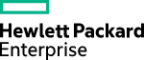
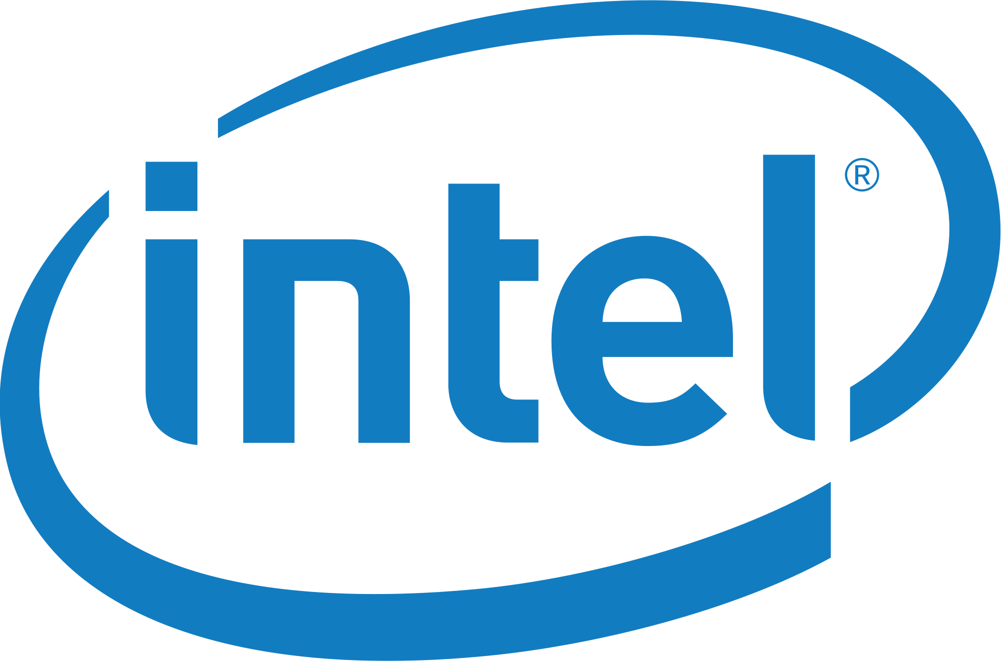
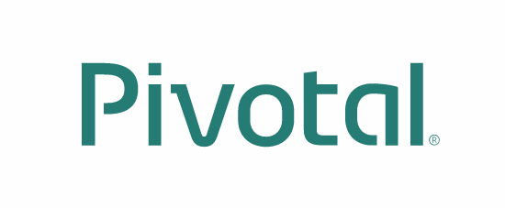
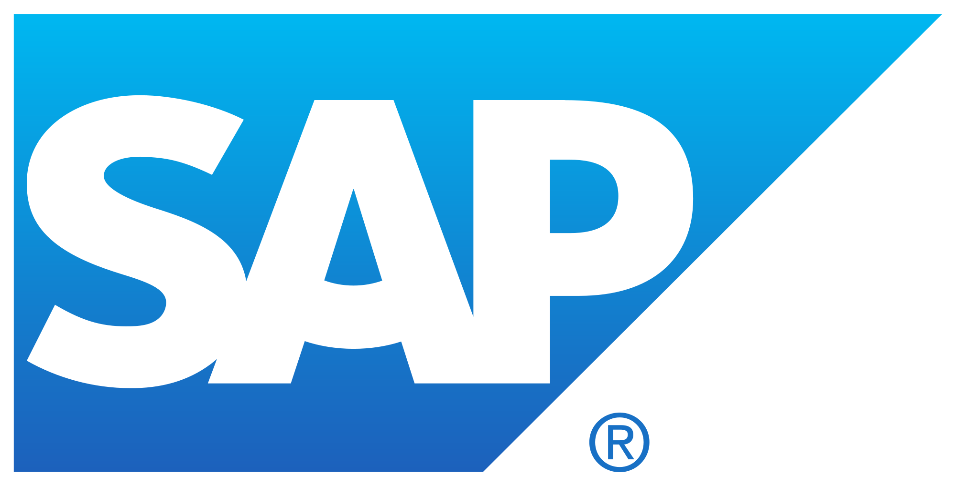




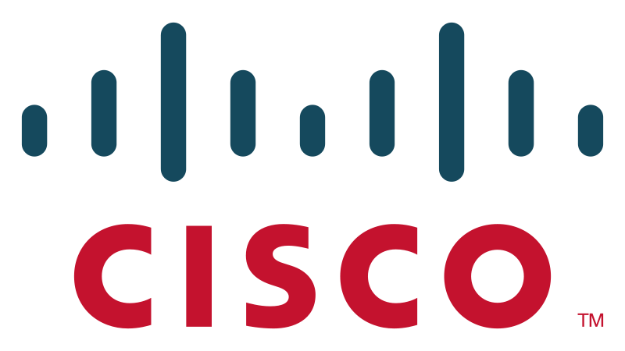



































Pivotal Cloud Foundry
An Open Industry Standard
PLATINUM
GOLD
SILVER
Notes:
Open source software offers true community-driven outcomes. Cloud Foundry Foundation has 40+ companies that participate in the community with a vested interest in a platform that continues to grow and meet customer needs, now and in the future.

Slide 24



CF Open Source Momentum
Commits
Submitters
53 corporations are contributing members
158 meetups in 49 countries
21K members with ~5K joining last month
~2200 developers, ~650 Code Submitters, ~400 of them in last year
65K commits with ~30K of those in the last year
Source: http://cloud-foundry.meetup.com/ on Jun 12 2015

Slide 25

Pivotal Cloud Foundry Commercialization Model
Open source software provides the basis for the platform
Commercial distribution provides value add features, enterprise services, support, docs, certs etc.
Notes:
Our company may be young, but the codebase has developed over many years. Many of the original developers are still at Pivotal.
Cloud Foundry Open source software provides the foundation for the Pivotal Cloud Foundry platform. Commercial distribution provides enterprise services, support, docs, certs etc.
For more differences between Opensource and PCF: https://sites.google.com/a/pivotal.io/inside-pivotal-competitive-intelligence-page/oss

Slide 26










ESI’s Cloud Foundry
Location
Independent
Polaris* Availability Zones x 3
*.px1.cfapps.internal.t-mobile.com
*.px2.cfapps.internal.t-mobile.com
*.px3.cfapps.internal.t-mobile.com
*.px1.cf.internal.t-mobile.com
*.px2.cf.internal.t-mobile.com
*.px3.cf.internal.t-mobile.com
ORACLE
vCenter
Network A
PCF /22 Net B
BOSH Net A, B
Cassandra Net TBD
TIBCO
Apigee
SQL
Ports: 80/443
DataStax /
Cassandra
BOSH
DC Going Away
Legacy
[ 6 x Nutanix ]
[ Dedicated ]
* Availability Zone arch same for Titan data center

Slide 27

Continuous
Delivery
DevOps
Cloud Native Platform
Micro services
Containers
Notes:
From Silicon Valley…

Slide 28
B r e a k
Notes:
(bold moves)
2015 – This is..
The year where we see a level of adoption of our products and services that propels us to becoming an ipo-worthy company
This is..the year where our great vision becomes a reality in production environments at the most important companies and organizations in the world.
This is the year that we show and teach our customers and partners the power and opportunity that building great software brings.

